Slide 1
Senior Design Introduction
Seunghoo Kim

Slide 2
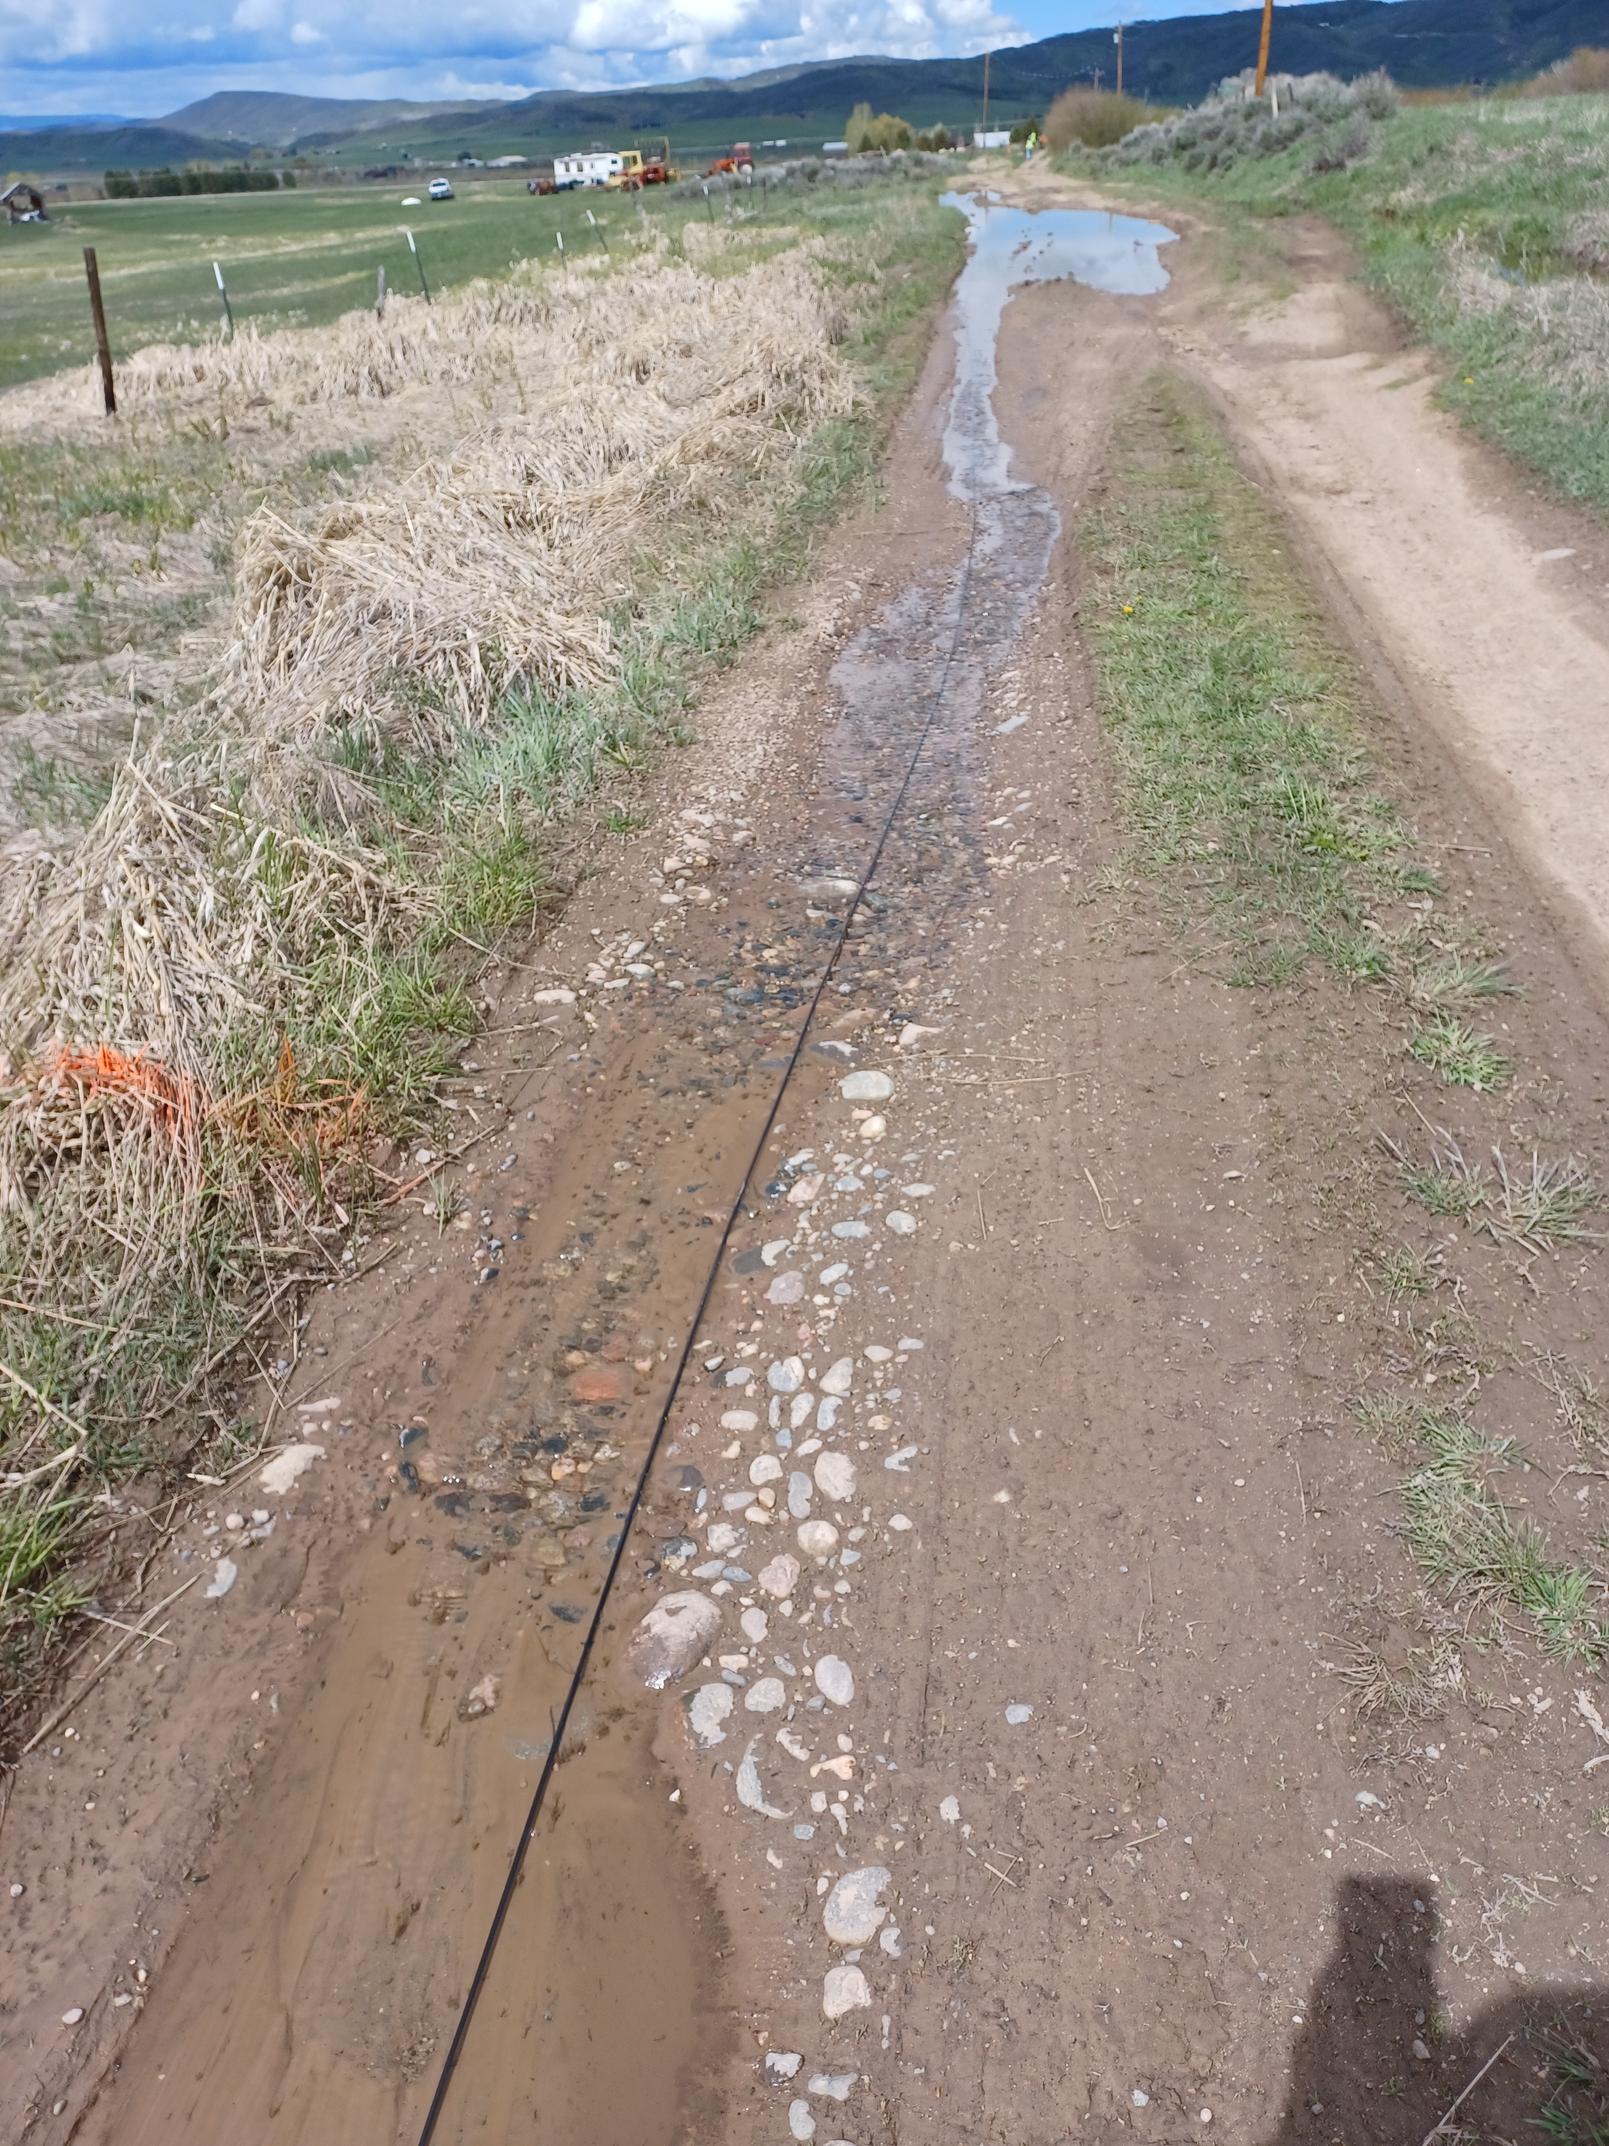
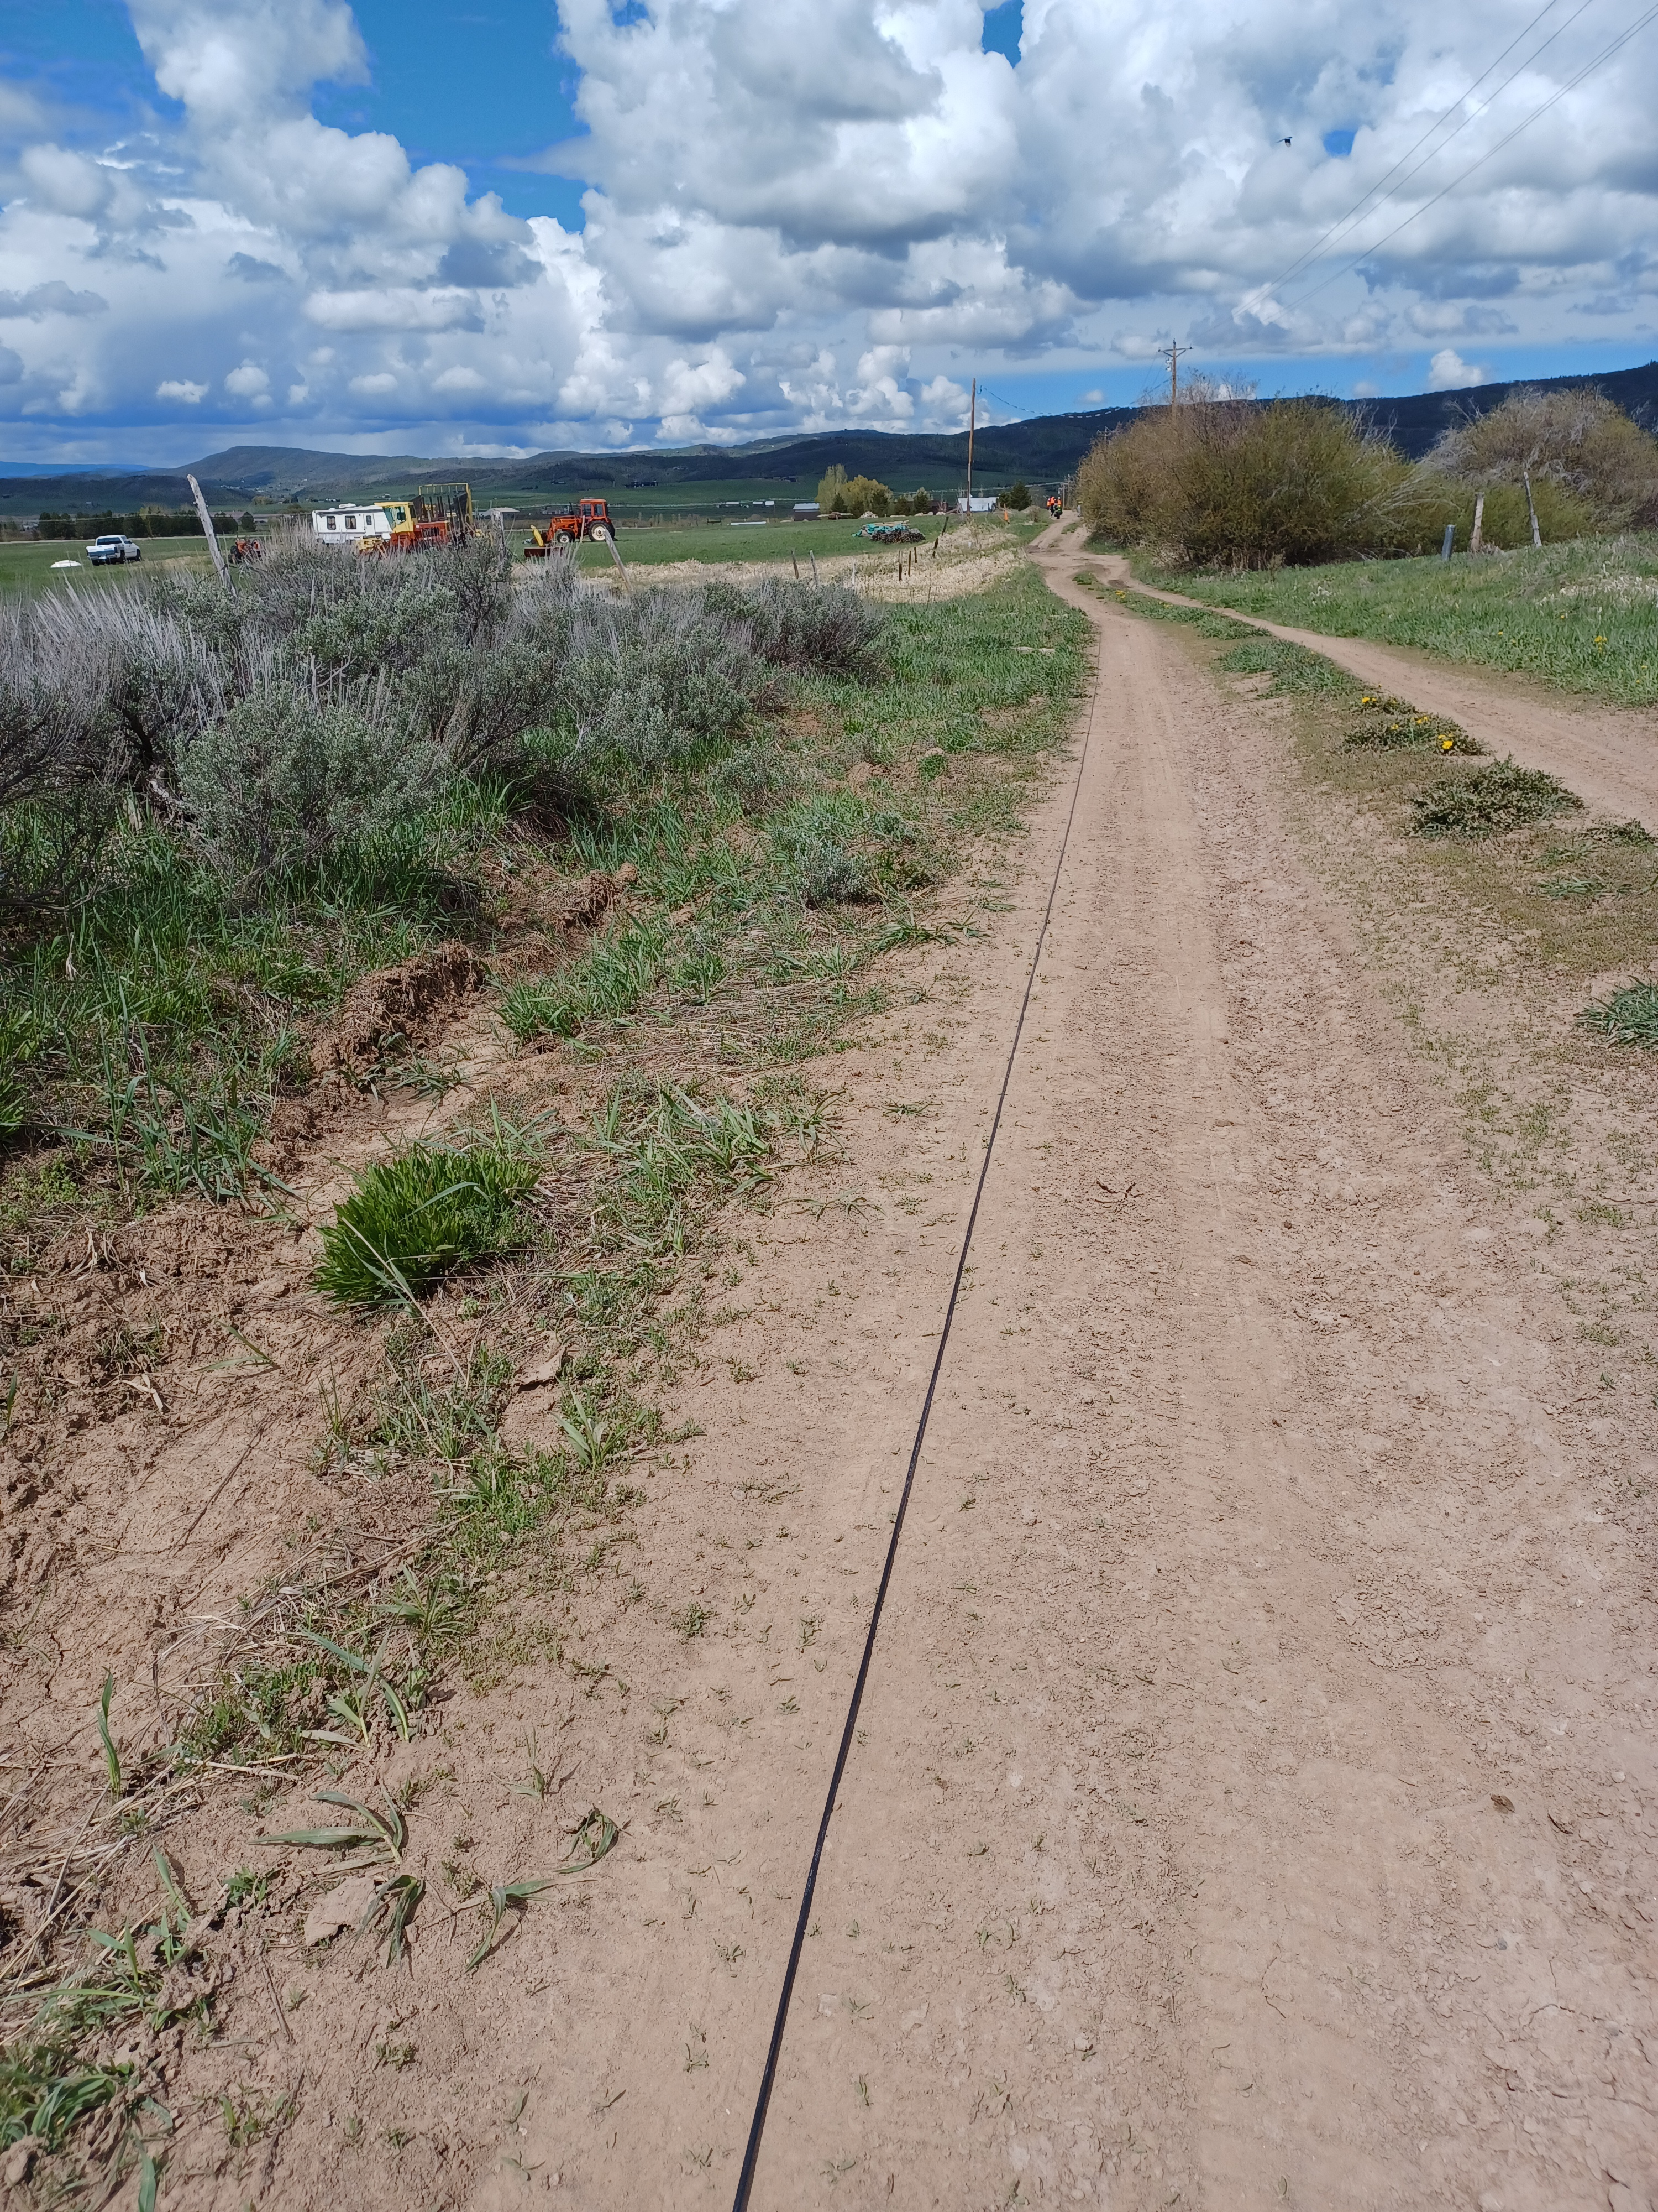
Goal: Detect channels with bad coupling
Puddle/running water and mud area​
Firm dirt ground material
Notes:
Goal: make a Python package or a module that automatically detects and classifies channels with bad coupling, and possibly either remove the data from the bad channels or do some processing on them.
The data collected during field camp was generally very bad, but there were some channels with better coupling. It would’ve been easier to use the data from the summer if there was a better way to deal with bad quality data.

Slide 3
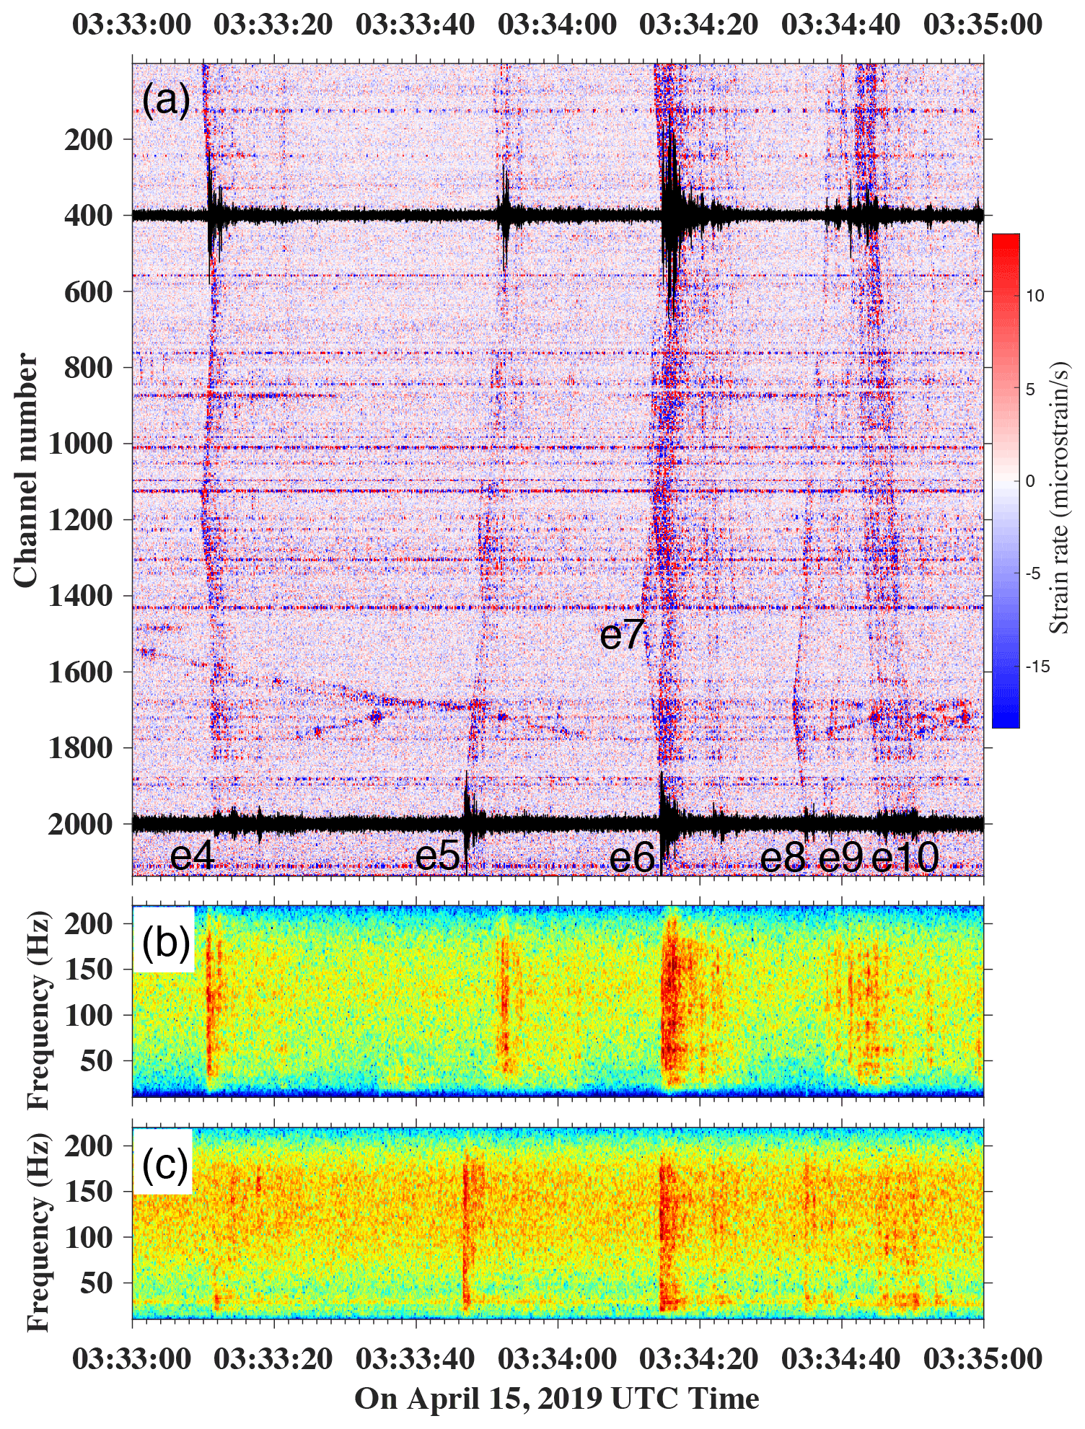
Datasets
Field camp data
FORESEE-urban (Urban DAS experiment on Penn State campus)
Brady’s Geothermal Field DAS Vibroseis data
Photonic seismology in Monterey Bay
Notes:
Figure on the right shows the thunderquakes picked up by FORESEE-urban data. (a) shows the thunderquake events on 15 April 2019. (b) and (c) show the DAS spectrograms (0-40 dB) computed for channel 400 and 2000.

Slide 4
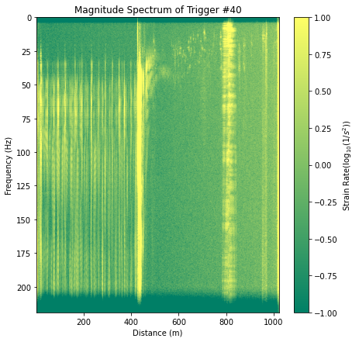
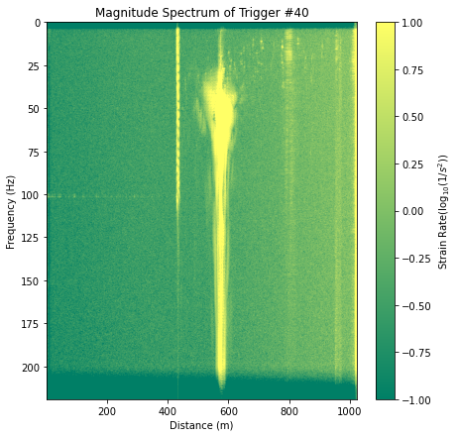
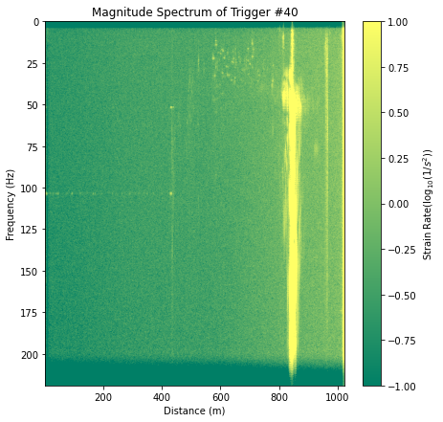
Approach 1: clustering
Magnitude Spectrum of Trigger Point #40 – Zoomed
Magnitude Spectrum of Trigger Point #70 – Zoomed
Magnitude Spectrum of Trigger Point #127 – Zoomed
Strain Rate (Log₁₀ (1/s²))
Strain Rate (Log₁₀ (1/s²))
Strain Rate (Log₁₀ (1/s²))
Frequency (Hz)
Frequency (Hz)
Frequency (Hz)
Distance (m)
Distance (m)
Distance (m)
Notes:
This is from the field camp data, after correlating the raw data with source wavelet. By finding the correlation between the data from all different source locations and classifying the clusters in which there are consistent “error” in the data where there is a strong signal when there shouldn’t be, the first step towards detecting badly coupled channels can be started.

Slide 5
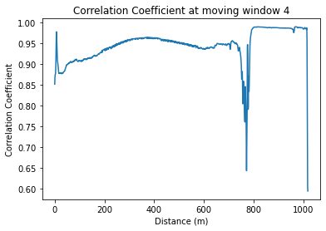
Correlation Coefficient
Correlation Coefficient at Moving Window 4
Correlation Coefficient
Distance (m)
Notes:
Using this method as a secondary verification

Slide 6
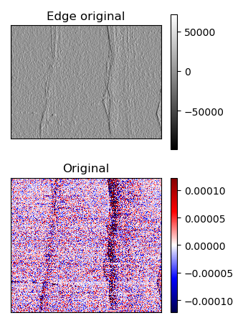
Approach 2
Use edge detection to detect events and classify channels
Notes:
See where the edge values are high. If some channels give high edge values with different source location, might signal bad coupling. Sobel edge detection was tested on a zoomed-in section of the thunderquake data.

Slide 7
To-Dos
More literature review to find more approaches I can take such as using computer vision for event detection
Explore the datasets more
Apply clustering as it seems the most promising so far
Test CNN based edge detection algorithms

Slide 8
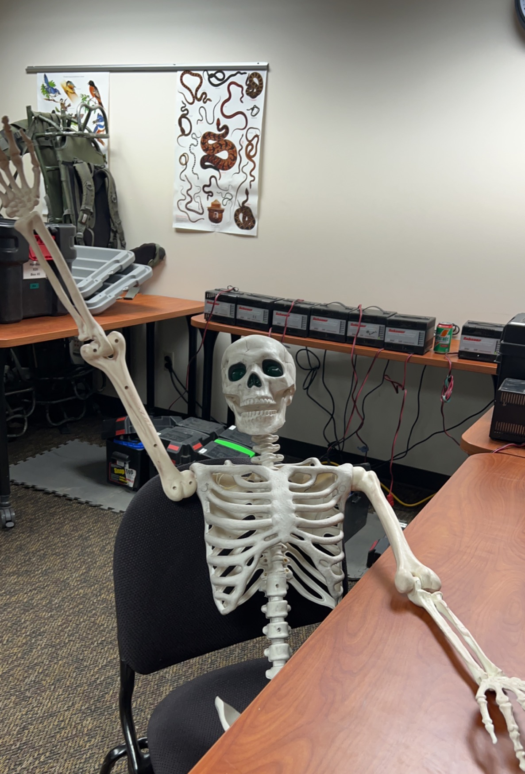
Thank you!

